Slide 1
Chapter 8 – Software Testing

Slide 2
Program testing
Testing is intended to show that a program does what it is intended to do and to discover program defects before it is put into use.
When you test software, you execute a program using artificial data.
You check the results of the test run for errors, anomalies or information about the program’s non-functional attributes.
Can reveal the presence of errors, NOT their absence.
Testing is part of a more general verification and validation process, which also includes static validation techniques.

Slide 3
Program testing goals
To demonstrate to the developer and the customer that the software meets its requirements.
For custom software, this means that there should be at least one test for every requirement in the requirements document. For generic software products, it means that there should be tests for all the system features, plus combinations of these features, that will be incorporated in the product release.
To discover situations in which the behavior of the software is incorrect, undesirable or does not conform to its specification.
Defect testing is concerned with rooting out undesirable system behavior such as system crashes, unwanted interactions with other systems, incorrect computations and data corruption.

Slide 4
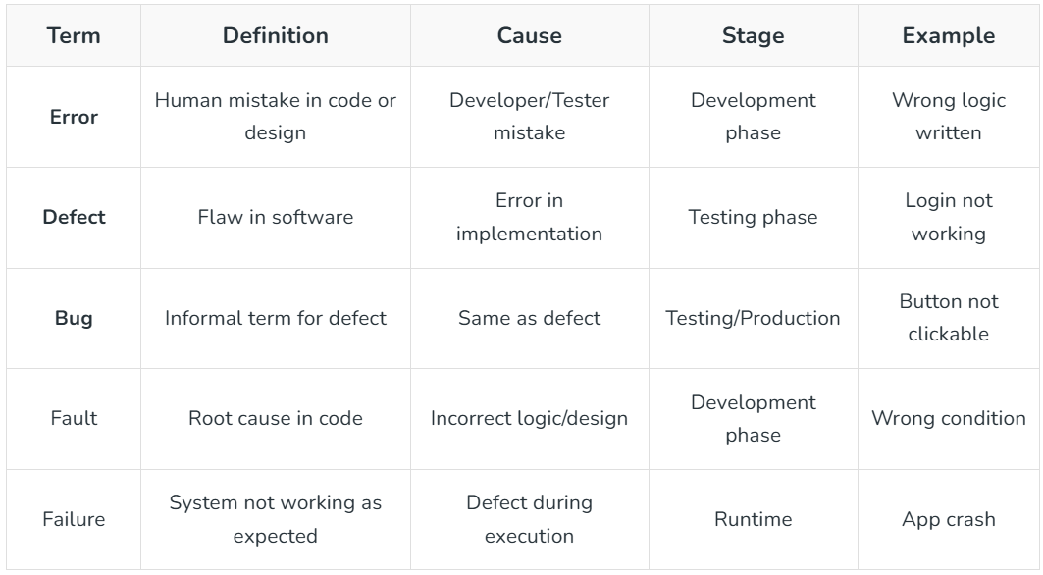
Bug vs Defect vs Error vs Fault vs Failure

Slide 5
Software Testing Strategies
Before testing starts, it’s necessary to identify and specify the requirements of the product in a quantifiable manner.
Specifying the objectives of testing in a clear and detailed manner.
For the software, identifying the user’s category and developing a profile for each user.
Developing a test plan to give value and focus on rapid-cycle testing.

Slide 6
Software Testing Strategies
Robust software is developed that is designed to test itself.
Before testing, using effective formal reviews as a filter.
Conduct formal technical reviews to evaluate the nature, quality or ability of the test strategy and test cases.
For the testing process, developing a approach for the continuous development.

Slide 7
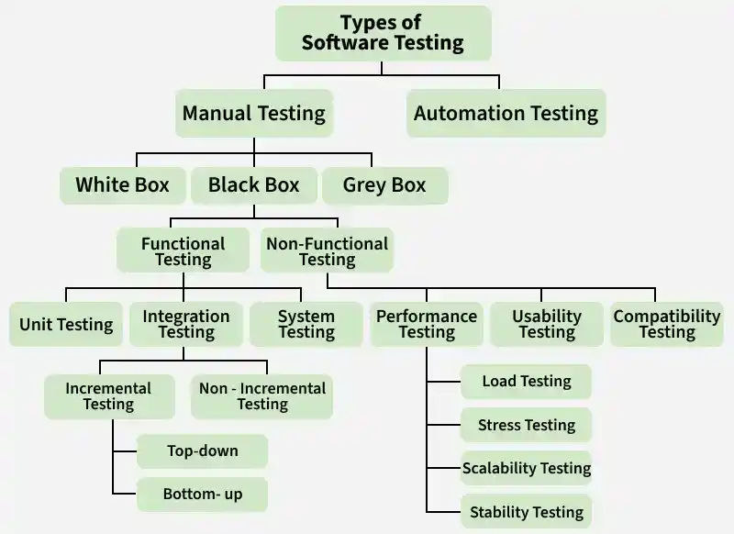

Slide 8
Overview
Software Testing is categorized into two main branches:
01
02
Manual Testing
Automation Testing
✓ Fast visual feedback
✓ Less expensive
✓ No coding required
✓ Great for unplanned changes
✓ Human intuition & judgment
✓ Simplifies test execution
✓ Improves test reliability
✓ Higher test coverage
✓ Minimizes human error
✓ Runs repetitive tasks easily
Further subdivided into: White Box • Black Box • Grey Box Testing

Slide 9
Types of Manual Testing
White Box Testing
Black Box Testing
Grey Box Testing
Tests internal code structure. Tester has full source code access. Focuses on paths, loops, and logic.
Tests functionality without knowledge of internals. Based on specs/requirements from user perspective.
Hybrid approach — partial internal knowledge. Tests both logic and user experience simultaneously.
• Thorough code testing
• Code optimization
• Early defect detection
• Integration with SDLC
• No coding skills needed
• Efficient for large systems
• User perspective testing
• Cases easily reproducible
• Clear goals for all
• User-centric approach
• Non-intrusive testing
• Improved product quality

Slide 10
Functional Testing
Under Black Box Testing
🔬 Unit Testing
🔗 Integration Testing
🖥️ System Testing
✅ UAT
Tests individual functions/methods in isolation. Done by developers early in SDLC.
Verifies that different modules work together. Includes Top-down, Bottom-up, Big-Bang.
Tests the fully integrated system against requirements before acceptance testing.
User Acceptance Testing — validates software meets business needs in real-world conditions.
🔄 Regression Testing
💨 Smoke Testing
🩺 Sanity Testing
🔁 End-to-End Testing
Ensures new changes don't break existing functionality via retesting and comparison.
Minimum tests on each build to confirm basic stability before deeper testing.
Quick check post bug-fix to confirm core functionality; stops if basics fail.
Tests entire software flow with all external interfaces and databases.

Slide 11
Non-Functional Testing
Testing system behavior, performance, security & usability
Performance Testing Types
Other Key Tests
Load Testing
Security Testing
Simulates concurrent users to find bottlenecks & max capacity.
Stress Testing
Uncovers vulnerabilities. Checks for compliance (HIPAA, PCI DSS). Prevents breaches.
Tests beyond normal load to verify stability under extreme conditions.
Spike Testing
Handles sudden large traffic bursts — identifies crash risks.
Stability Testing
Scalability Testing
Evaluates scale-up/down capability under varying user loads.
Ensures system functions over time without failure under different environment parameters.
Endurance Testing
Long-term load to find memory leaks and performance degradation.
Soak Testing
Compatibility Testing
Sustained load over prolonged period to find hidden weaknesses.
Volume Testing
Verifies app runs on all platforms, devices & browsers consistently.
Large database volumes to check system behavior at scale.

Slide 12
White Box Testing — Deep Dive
🛤️ Path Testing
🔁 Loop Testing
🧩 Unit Testing
Checks all possible execution paths in the program. Reduces redundant tests and focuses on code logic.
Validates loops (for/while) in code. Ensures no infinite loops, correct variable handling inside loops.
Tests individual functions/methods directly at code level. Popular frameworks: JUnit, NUnit, xUnit.
🧬 Mutation Testing
🔗 Integration Testing
🛡️ Penetration Testing
Modifies code in small ways to evaluate test quality. Finds ambiguities and loopholes in source code.
Verifies internal logic between modules. Tester understands code of modules being integrated.
Simulated cyber attacks to find security vulnerabilities — APIs, servers, input injection risks.

Slide 13
Integration Testing Approaches
💥 Big-Bang Integration
⬇️ Top-Down Integration
All modules combined and tested at once. Simple, quick — best for small systems.
High-level modules tested first, low-level later. No drivers needed. Early interface error detection.
✓ Simple • Fast • Straightforward
✓ Early error catch • Easier test cases
⬆️ Bottom-Up Integration
🥪 Mixed / Sandwich Integration
Low-level modules tested first, then integrated upward. OOP-friendly with high success rates.
Combines top-down and bottom-up. Ideal for very large projects with multiple sub-projects.
✓ Easy to observe • No structural design info needed
✓ Parallel testing • Overcomes both approach limits

Slide 14
Other Important Testing Types
🅰️
🅱️
📋
🧭
🐒
Alpha Testing
Beta Testing
Acceptance Testing
Exploratory Testing
Adhoc / Monkey Testing
Internal QA testing before product release. Identifies early bugs cost-effectively.
Limited real users in real environments. Gathers feedback, reduces failure risk post-launch.
Customer validates product meets requirements. Involves users directly in testing.
Unscripted testing using tester's knowledge. Quickly finds critical defects.
Random informal testing after formal testing. Finds bugs not covered by test cases.
⚖️
🖼️
♻️
🌍
📍
A/B Testing
GUI Testing
Recovery Testing
Globalization Testing
Localization Testing
Compares two versions of an asset. Reduces risk, informs data-driven decisions.
Tests UI elements — layout, fonts, buttons, links. Validates user experience.
Tests crash recovery. Ensures app returns to normal state after unexpected failures.
Verifies app works across languages, cultures, and geographies.
Tests specific locale/culture version of the product for correctness.

Slide 15
Software Testing — Pros & Cons
✅ ADVANTAGES
❌ DISADVANTAGES
✅
Customer Satisfaction
⏱️
Time-Consuming
App works as expected, builds trust
Adds time and cost to the project
💰
Cost-Effective
Early bug detection saves future expenses
🐌
Slows Dev
🏆
Quality Product
Can slow down the development process
High quality, compatibility & user expectations met
Bug-Free App
🚫
Not Exhaustive
🐛
Not all defects can be found
Finds & fixes bugs for smoother operation
🔒
Security
🧩
Complex Systems
Checks for vulnerabilities, protects sensitive data
Hard to fully test complex architectures
⚡
Speed Up Dev
Issues caught early = faster delivery
👤
Human Error
🔍
Early Detection
Testers can introduce errors during testing
Issues found and fixed sooner in development
📈
Reliable Product
Ensures product meets user needs consistently

